Slide 1
IoT based Smart Soil Nutrition Monitoring System for Sustainable Agriculture
GUIDED BY PRESENTED BY
MS. R. ASWINI, GUHAN k
AP/IT.

Slide 2
ABSTRACT
The IoT-Based Smart Soil Nutrition Monitoring System project aims to increase and enhance agriculture by integrating the Smart Sensor System with the Blynk web console.
With the help of smart agriculture monitoring we can collect important data about the behavior of Crops in the field. With the help of this smart monitoring we can find out and observed the behavior of plants.
After Collecting data, data could be send on IoT platform. The project follows a systematic approach, including requirement analysis, system design, implementation, testing, and deployment.
Challenges such as integration complexity and software compatibility were addressed through collaboration and iterative development.
Initial results show promising outcomes in terms of remote monitoring and control capabilities, with the system successfully integrating with the Blynk platform.

Slide 3
PROJECT OBJECTIVE
The specific objectives of an IoT based smart agriculture monitoring system may include:
To decrease the amount of manual labor.
To Developing an integrated system of sensors and actuators that can collect and transmit real-time data about soil moisture, temperature, light intensity, air quality, and other relevant factors.
To take the update about the crop behavior from anywhere when climate suddenly vary.
To take action against toxic gases though fertilizers and antioxidant.
To Lowering costs by reducing waste and improving efficiency in crop management.
To monitor the Temperature and Humidity level of the crops in the field.

Slide 4
SCOPE OF THE PROJECT
Some potential areas of scope for an IoT Based Smart Agriculture Monitoring System project could include:
With the help of sensors, the labor need will decrease.
The sensor allows precisely measure the moisture level of soil.
The gas sensor will detect different toxic gases. With the help of gas sensor farmers and labors will take action on accurate time to save crops from bad growth.
The temperature sensor detects the temperature level precisely and accurate than the manual process.
This may involve using statistical methods and other analytical tools to process the data collected by the system and generate useful insights .

Slide 5
METHODOLOGY
Requirement Analysis: Identifying the requirements for IoT integration and remote monitoring.
System Design: Designing the architecture for integrating the Soil Nutrition Monitoring System with the Blynk web console.

Slide 6
METHODOLOGY
Implementation: Updating the hardware and software components, configuring the Blynk dashboard, and programming communication protocols.
Testing and Validation: Conducting testing to ensure the reliability and functionality of the IoT-based Soil Nutrition Monitoring System.

Slide 7
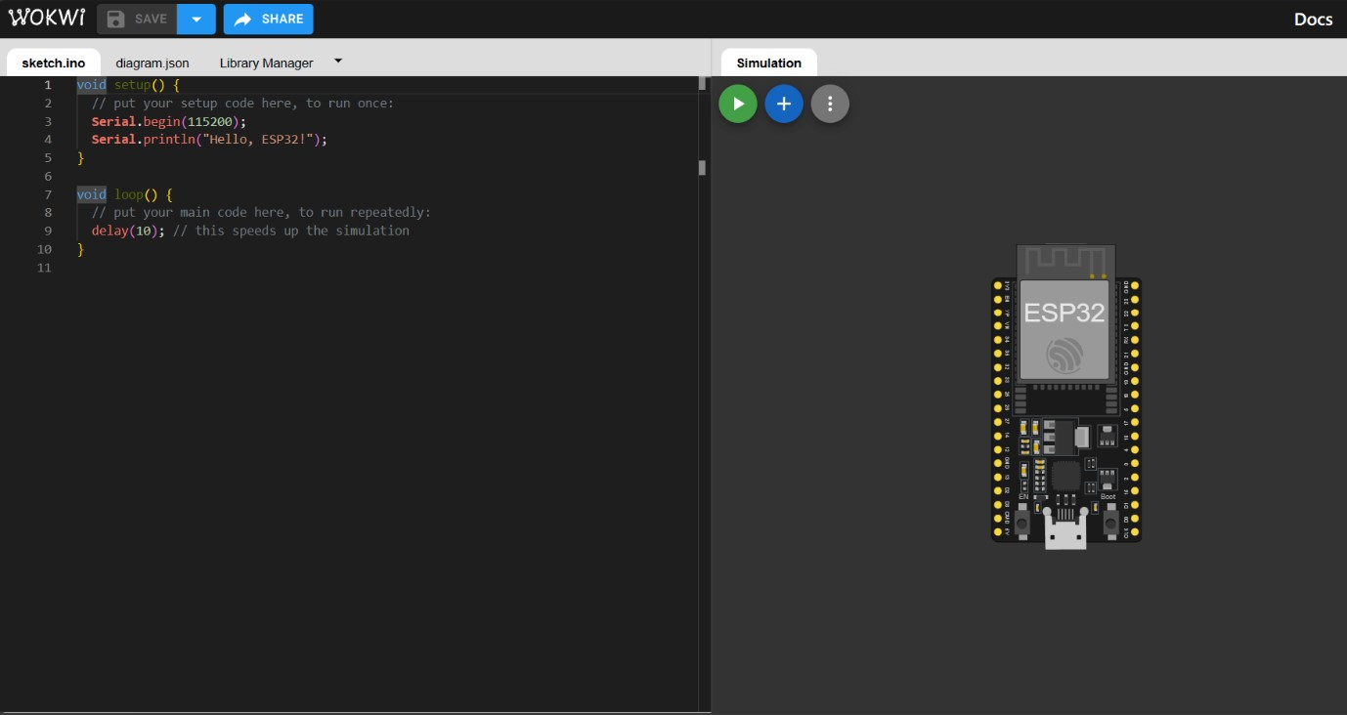
OUTPUT 1- ESP32 The ESP32 is a popular WiFi and Bluetooth-enabled microcontroller, widely used for IoT Projects.

Slide 8
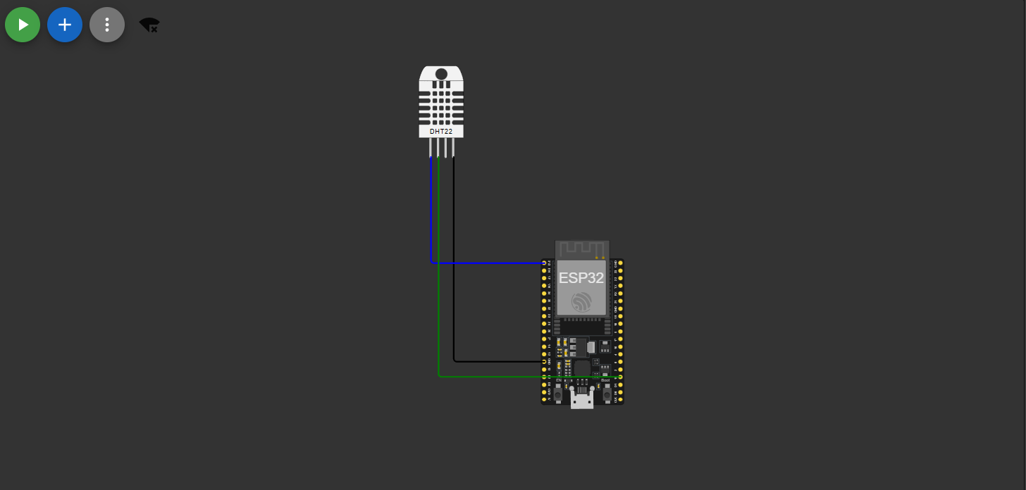
OUTPUT 2- DHT22 Digital Humidity and Temperature sensor

Slide 9
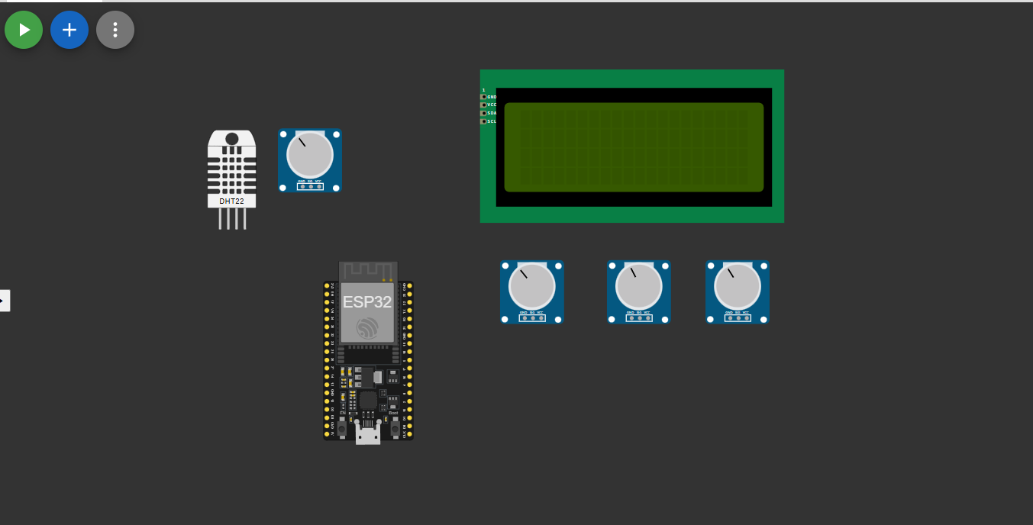
OUTPUT 3- potentiometer Knob-controlled variable resistor (linear potentiometer)

Slide 10
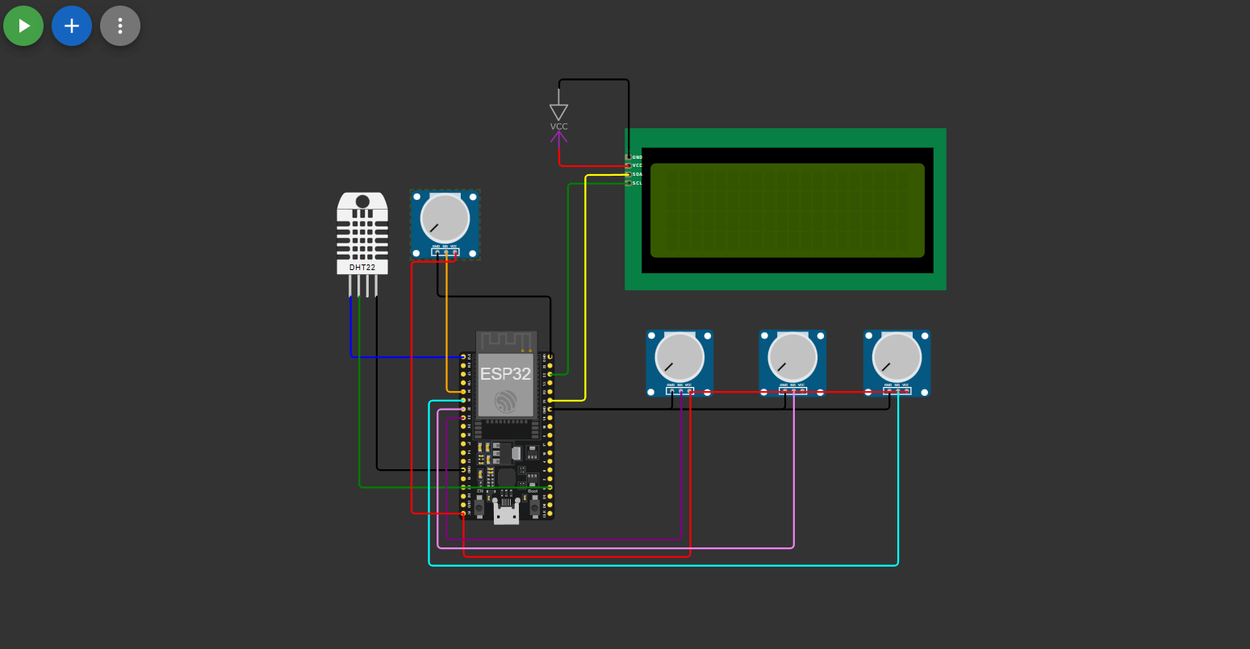
OUTPUT 4- CIRCUIT DIAGRAM

Slide 11
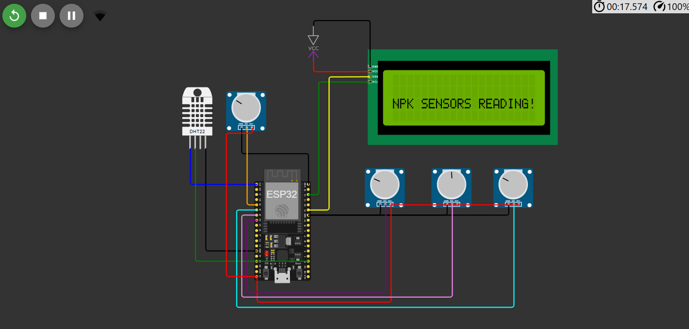
OUTPUT 5- Nitrogen, phosphorous, potassium SENSOR READING

Slide 12
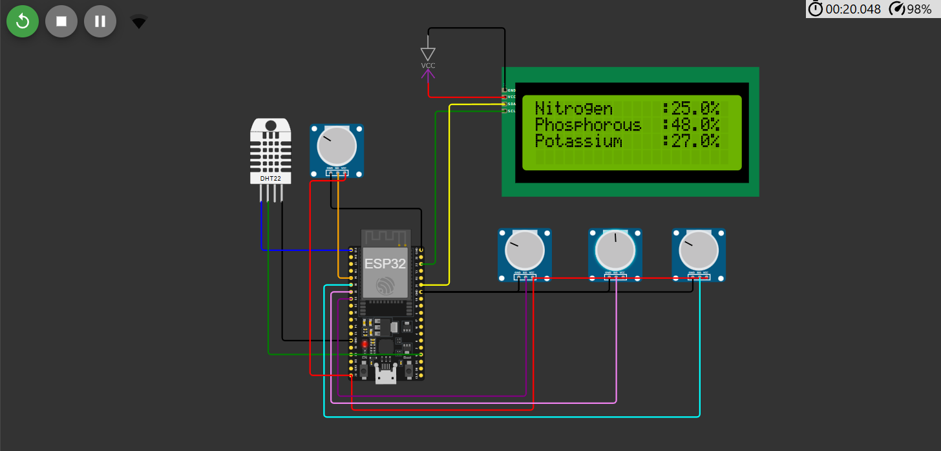
OUTPUT 6- Nitrogen, phosphorous, potassium SENSOR READING

Slide 13
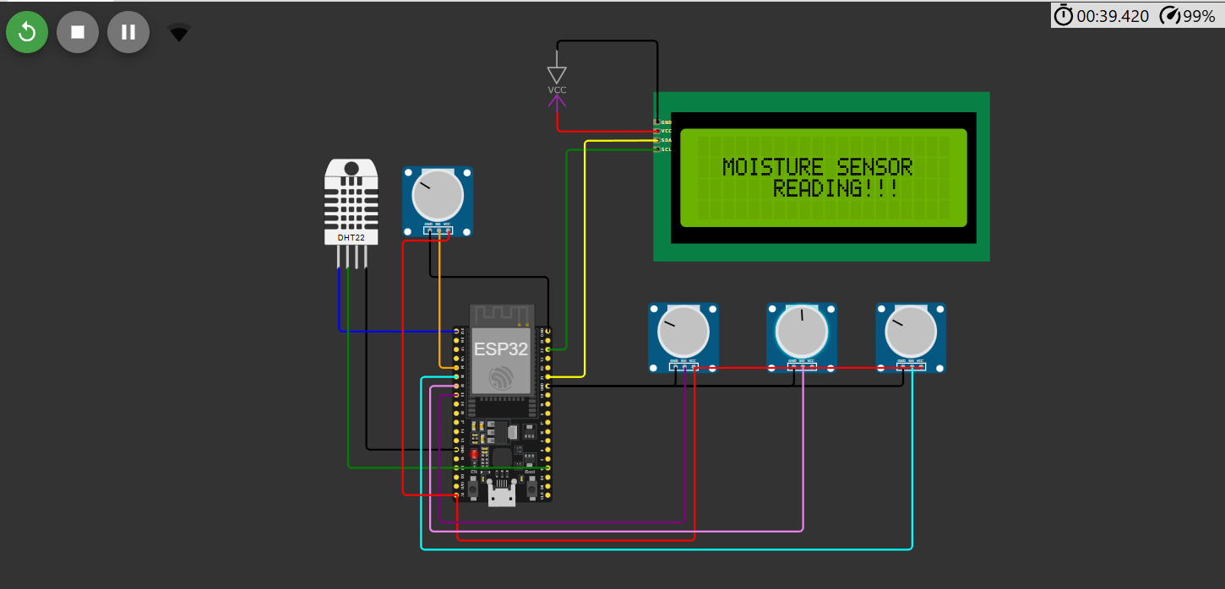
OUTPUT 7- MOISTURE SENSOR READING

Slide 14
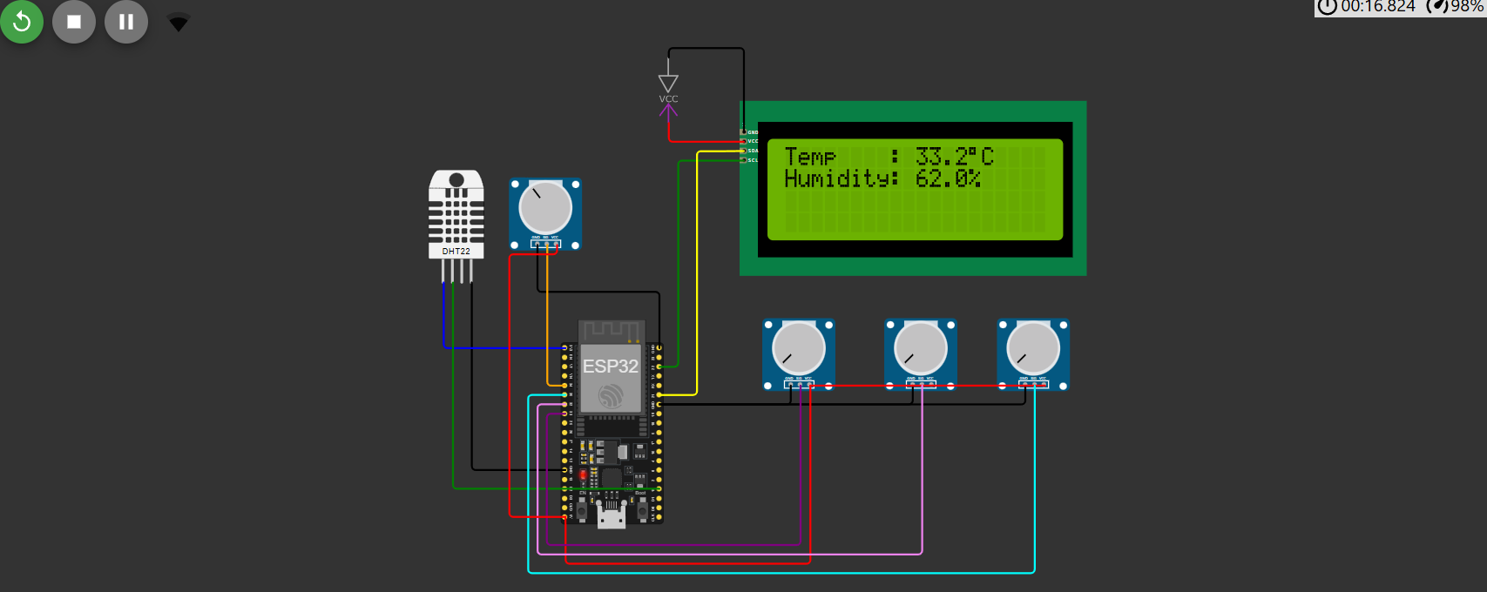
OUTPUT 8- MOISTURE SENSOR READING

Slide 15
TECHNICAL COVERAGE
Those places where temperature suddenly vary with the help of this we can monitor temperature easily.
Crops where we can’t monitor the different required parameters of crops. • All those areas where industrial toxic gases effect on crops health.
Areas where labor can’t go and unable to access, we can easily monitor crop variable on real-time.

Slide 16
result
The initial results of the project demonstrate promising outcomes, particularly in terms of remote monitoring and control capabilities: reasons why soil moisture sensor is useful in this context:
Automation of Irrigation System: By measuring the soil moisture levels, the sensor can be used to control the irrigation system to automatically provide water to the crops only when it is needed, improving the efficiency of water usage and reducing waste.
Real-time monitoring: The sensor can be connected to the internet through a microcontroller or gateway and the data can be monitored in real-time using a mobile application or web portal, enabling farmers to make informed decisions about irrigation.
Early warning: By monitoring the soil moisture levels, the sensor can provide early warning of potential issues, such as dry soil or waterlogging, allowing farmers to take action before the problem becomes severe.
Adaptability: Soil moisture sensors can be used in a variety of crops and soil types, making them a versatile tool for farmers and growers.
Cost-effective: Soil moisture sensors are relatively inexpensive, making them a cost effective solution for automating irrigation systems.
Water saving: By providing accurate data about the soil moisture, the sensor can help farmers to save water and reduce the water consumption.

Slide 17
CHALLENGES AND RESOLUTIONS
The challenges and resolutions for an IoT-based Smart Soil Nutrition Monitoring System:
1. Data Accuracy and Sensor Reliability
Resolution: Regular calibration, using multiple sensors for verification, and employing advanced sensor technology.
2. Data Integration and Management
Resolution: Use standardized protocols for data transmission and develop a centralized data platform.
3. Connectivity Issues
Resolution: Implement offline data storage and use alternative communication methods like satellite or LPWAN for remote areas.

Slide 18
CHALLENGES AND RESOLUTIONS
4. Power Consumption
Resolution: Design for energy efficiency and use renewable energy sources such as solar panels.
5. Data Security and Privacy
Resolution: Apply encryption for data transmission and enforce strong access control measures.
6. User Training and Adoption
Resolution: Create user-friendly interfaces and provide comprehensive training and support for effective system use.

Slide 19
CHALLENGES AND RESOLUTIONS
4. Power Consumption
Resolution: Design for energy efficiency and use renewable energy sources such as solar panels.
5. Data Security and Privacy
Resolution: Apply encryption for data transmission and enforce strong access control measures.
6. User Training and Adoption
Resolution: Create user-friendly interfaces and provide comprehensive training and support for effective system use.

Slide 20
CONCLUSIONS
In conclusion, the IoT-based smart agriculture monitoring system offers a practical and effective solution for farmers to monitor and optimize the growth of their crops.
By collecting and analyzing data on various environmental factors such as temperature, humidity, soil moisture, and light intensity, the system provides farmers with valuable insights into the health and growth of their crops.
Through the use of sensors, the system can detect potential problems such as pests, diseases, and nutrient deficiencies, allowing farmers to take prompt action to prevent or mitigate these issues. The system also enables farmers to automate various tasks such as irrigation and fertilization, saving time and resources while improving crop yields.
For example, integrating artificial intelligence and machine learning algorithms could improve the accuracy of data analysis and prediction of crop growth and yield. Additionally, incorporating drone technology for aerial monitoring of crops could provide even more detailed insights into crop health and growth.

Slide 21
THANK YOU

